Slide 1
Warpage, Adhesion, and Reliability

Slide 2
Thermal and Chemical Stress in Assemblies
Thermal stress is created by temperature excursions during assembly and product life
  Joining materials with different CTEs can cause stress failures
    Silicon and glass differ widely from organics and metals
Chemical shrinkage stress is created during the cure of an epoxy (or any thermoset resin)
  Temperature of cure and extent of cure directly affects chemical stress
Crosslinking polymers tend to form non-uniform agglomerates with thermal reaction fronts which lead to internal stress fractures
Note:
  Once the extent of cure is complete, the stress properties do not change
  Incompletely cured epoxies will change properties with higher temperature steps (extent of cure changes) producing unexpected shrinkage stress.
Notes:
- Basic knowledge – many know –want everyone on the same page
- Silicon gets the stress - 3 reflows for reliability

Slide 3
Compression Stress From “CTE–Mismatch”
Co-efficient of thermal expansion mis-match between materials
Lower the cure temperature!
  Lower stress from CTE mis-match
    Cure time increases rapidly
    Glass formation stops cure
die CTE = 3 ppm/°C
heated to 165°C
165°C cure temp = 2100 ppm difference
100°C cure temp = 1125 ppm difference
board CTE = 18 ppm/°C
heated to 165°C
Courtesy: IBM

Slide 4
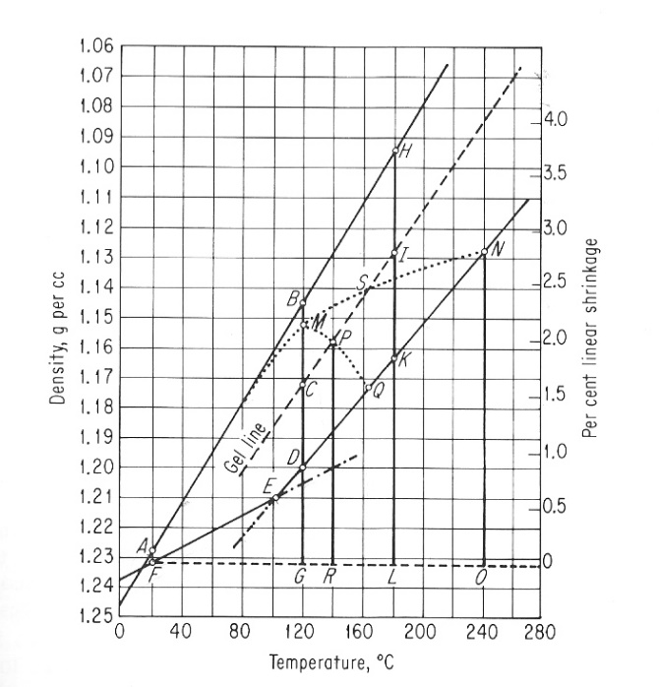
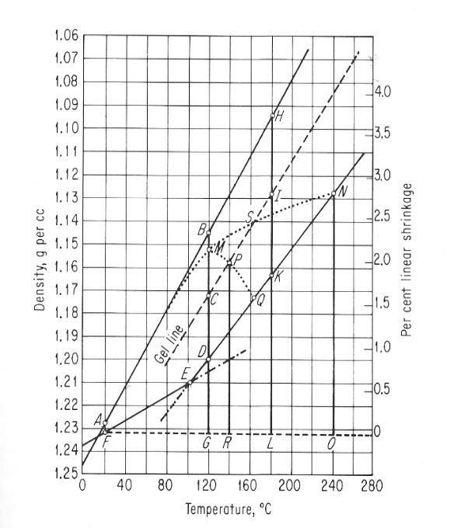
Epoxy Shrinkage Stress During Cure
Cure temperature directly affects total shrinkage stress
  Shrinkage begins at gelation point
  Temperature difference between gelation and room temperature
Great! Let’s all use lower cure temperatures!
180C cure
120C cure
shrinkage
shrinkage
same Tg
Lee & Neville, Handbook of Epoxy Resins, 1967.

Slide 5
Adhesion Depends on Extent of Cure
Resin (epoxide) and hardener (amine example):
  Each reaction creates a strong source of adhesion to surfaces
Networks are formed from linear and crosslinked connections
  More connections = greater adhesion
  More connections = higher Tg (extent of cure)
Increasing network density reaches the critical point of gelation
  viscosity rises rapidly; mobility and reaction rate drops rapidly
  As the cure Tg increases, the cure temperature must be increased

Slide 6
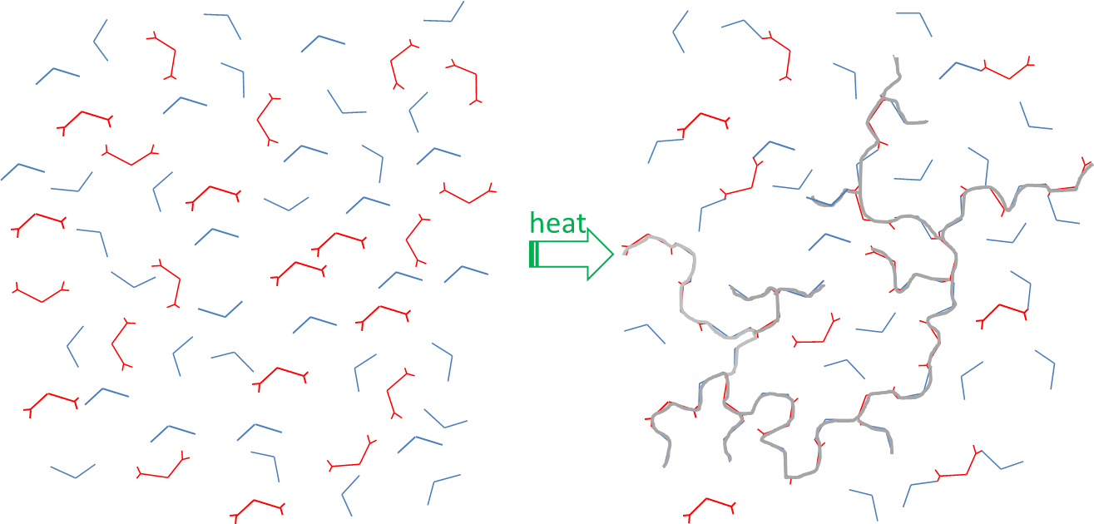
Fluid Resin to Rigid Gel
A molecular backbone spanning the whole system defines “gelation”.
Backbone is now rigid so continued cure requires increasing temperatures.
Cure temperatures are usually set 20-50°C above Tg∞ for full cure.
Notes:
- “Alternative Cure Schedules”

Slide 7
Problems with Incomplete Cure Reactions
At the gel point the cure reaction may be only 30-50% complete
  As the temperature is raised the reaction (and adhesion) can continue
  If temperature is not kept 10-15°C above Tg, a glass (solid) forms
  Time at a lower temperature must increase by 1000X
Film adhesives are incompletely cured glasses (on purpose)
Adhesion will not increase without higher temperature
The incompletely cured joint will soften at low temperatures
If the joint temperature is raised above Tg at a later process step:
  The cure reaction will continue with:
    Increased epoxy shrinkage
    Decreased coefficient of thermal expansion
    Potential movement and shifting of parts
    Creation of voids and cracking in adhesive and between parts
Back to high temperature curing, and high total stress!
Notes:
- Ask me about a life threatening example some time

Slide 8
Microwaves are Rotational Energy
Electromagnetic Spectrum
  Gamma Rays Nuclei
  X-Ray Inner Electrons
  UV Covalent Bond Disruption
  Visible
  IR Molecular Vibration
  Microwaves Molecular Rotation
  RF Charge Flow
Microwave fields excite electron distributions in molecules which cannot follow the rapid reverses in the e-field, causing rapid rotational motion and accelerated chemical reactivity.
No bonds are broken with microwave fields
Ionizing
Radiation
Non-Ionizing
Radiation

Slide 9
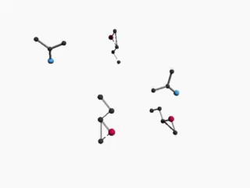
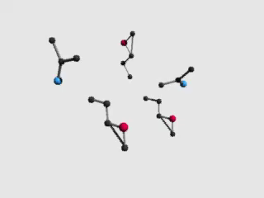
Microwaves Increase Polymer Mobility
click to animate
click to animate
Molecules are spinning; cure reactions continue; adhesion increases

Slide 10
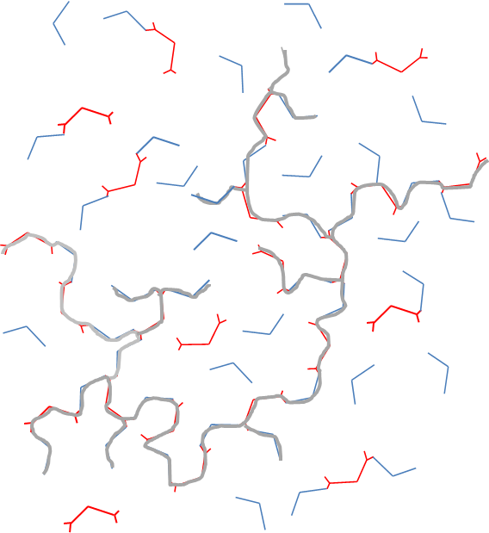
Low Temp? Back to the Rigid Gel Network
“infinite polymer”

Slide 11
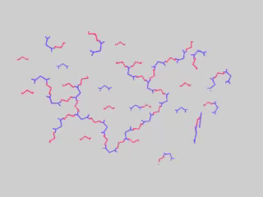
Mobility of Backbone with Microwave Rotation
click to animate
Gel state mobility allows the cure reaction to continue at low temperature only with microwaves.
Notes:
- Reds = Epoxides Blues = Diamines

Slide 12
Applications for Adhesives and Molding

Slide 13
Flip-Chip Underfill Epoxies
Published examples of very low temperature VFM cures
175°C
150°C
125°C
100°C
50°C
oven
oven
oven
oven
oven
oven
Tg∞
Tg∞
Tg∞
Tg∞
VFM
VFM
Tg∞
VFM
VFM
Tg∞
VFM
VFM
Henkel FP4527
(ECTC-2010)
Henkel UF8830
(ECTC-2010)
Namics U8410
(DPC-2011)
UF #B
(IBM-2013)
UF #C
(IBM-2013)
BFDGE/MDA
J. Appl. Polym. Sci.
(2016)
Notes:
People have been using VFM for low temperature cure of thermoplastics for decades
This is where I get to tell you how to use low temperature cures for thermosets safely
Wait! BELOW Tg !!

Slide 14
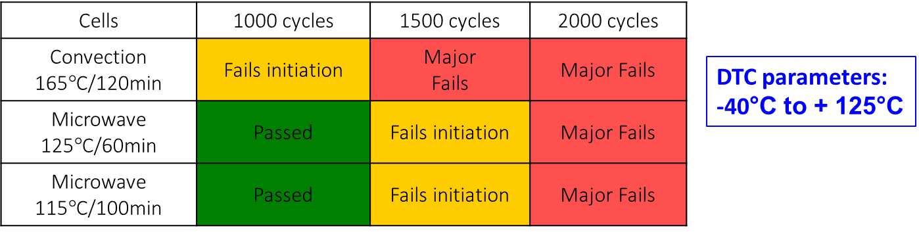
IBM Warpage and Reliability Results
P7 μprocessor package with 22% less warpage with VFM
convection warpage
reference
iMAPS, 2011
with permission

Slide 15
Additional Low Warpage Results
TSMC, US Patent 8,846,448
  Lower package-on-package (PoP) warpage with VFM
  Minimized voids in electrically-conductive adhesive
IBM, ECTC 2015, eliminate void bake-out step with VFM
SMTA International, 2016
  Warpage reduced by 44% with VFM on 17mm die on 40mm substrate (1440 I/O)
  40% silica filler lower warpage than 60% (faster underfill times also)
  Lower warpage without elastomer additive!
courtesy IBM

Slide 16
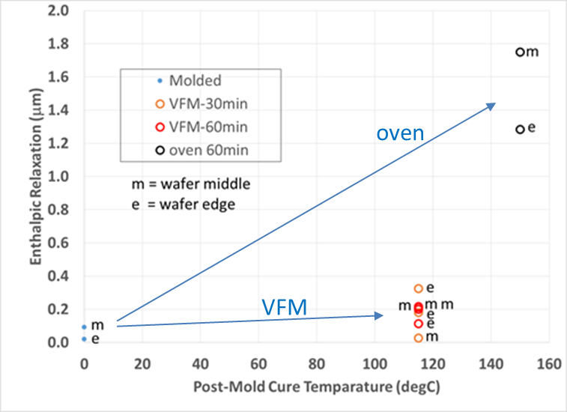
Embedded Wafer Molding
300mm epoxy molded wafer (Applied Materials)
  20% lower warpage with post-mold VFM cure
  85% reduction in final heat shrinkage with VFM
  120°C with VFM vs. 150°C with oven
  VFM cure uniformity better across wafer

Slide 17
Low Temperature VFM Cure = Low Stress
Low temperature cure of epoxies (~50°C lower than oven)
  Full extent of cure, full adhesion, and maximum Tg∞
  Cure well below Tg∞ temperature without forming a glass
  Similar cure times or faster
Sources of stress in both assemblies and materials
  Lowered thermal stress between CTE mis-matched materials (i.e. silicon/BT)
  Lowered shrinkage stress from lower temperature cure
  Reduced aggomerate thermal front stress in the epoxy material
Commonly used additives to modify epoxies;
  Silica added (60-90%) to lower CTE no longer necessary
  Elastomers added to lower modulus no longer necessary
  Faster dispense time; fewer reliability issues with additives
Other thermosets show similar improvements (even vinyls and acrylates)

