Slide 1
Variable Frequency Microwaves

Slide 2
Variable Frequency Microwaves
Dielectric relaxation creates molecular rotation
Standard microwave generators are single frequency, single mode
Multiple scanned frequencies (VFM)
  4096 frequencies, each 260 Hz wide, for only 25 μs each
C-band: 5.85-7.0 GHz
5.85
7.0

Slide 3
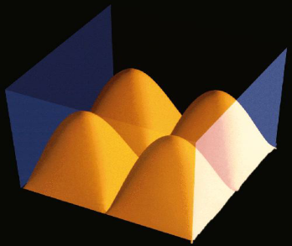
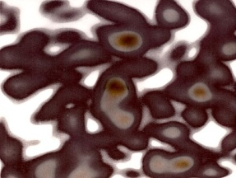
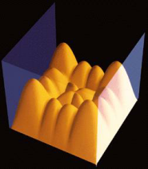
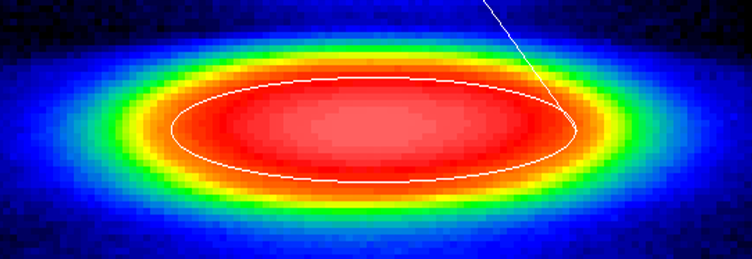
Why Variable Frequency Microwave (VFM)?
Single (fixed) frequency creates
spacial nodes of high and low
energy distribution
Variable Frequency Microwaves
mixes nodes every 25 μs for
uniform energy distribution
no metal arcing
thermal paper
wafer edge

Slide 4
Inherent Advantages
The obvious: rapid chemical reaction rates
Not obvious: much lower temperature processing
Lower material stresses from lower temperature processing
Highly uniform energy field (and temperature +/- 3°C)
Selective application of energy to target materials
Digital, programmable, multi-step processing

Slide 5
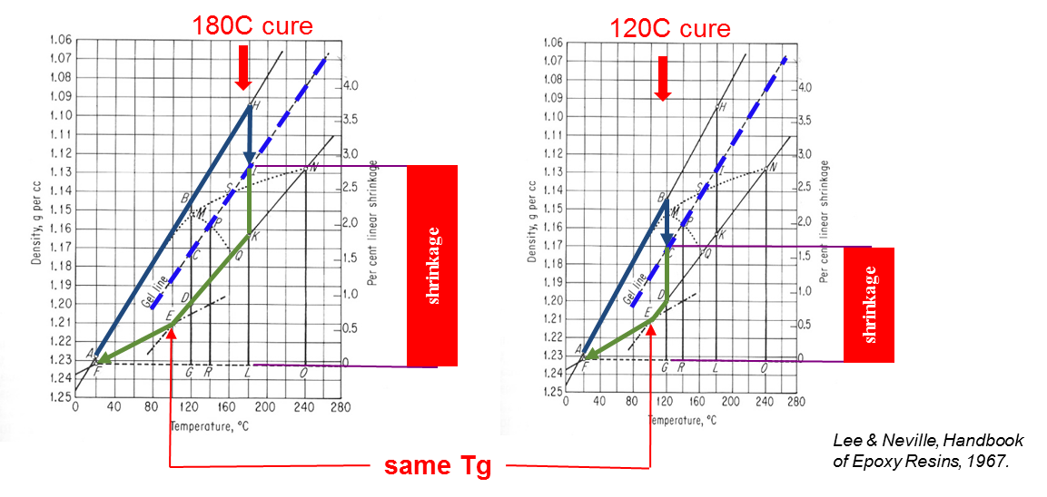
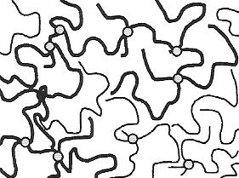
Inherently Low Temperature
Protection of temperature-sensitive components
  Maximum thermal budgets are lowered (50°C - 100°C)
Relief of CTE-mismatch stress between thermally different materials
  Bonding of glass and ceramics to organics and metals
Lowered shrinkage stress in adhesives
Reduced internal stress fractures from non-adiabatic thermal fronts
<100°C
150°C

Slide 6
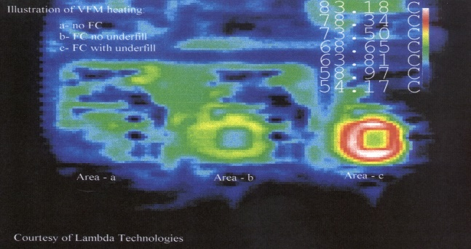
Selective Assembly By Material
Normal example: solder selection
  High temp solder before low temp solder in process flow
VFM ONLY heats un-cured resins (and silicon)
VFM examples:
  Any curing step can precede any other (cured resins are unaffected)
  Carbon-fiber loaded plastic heats without affecting un-loaded plastics
  Solder reflow by heating silicon die (high Pb, no Pb)
  Die attach or under-fill cure without heating board or other components
curing adhesives

Slide 7
Programmable Control of Energy
Digitally programmed feedback loop for flexible energy control
As cure completes, the material becomes “transparent” to VFM
  Does not “overcure” or decompose (burn)
VFM is proprietary to Lambda Technologies, Inc.
sample
temperature
measured
power adjusted

Slide 8
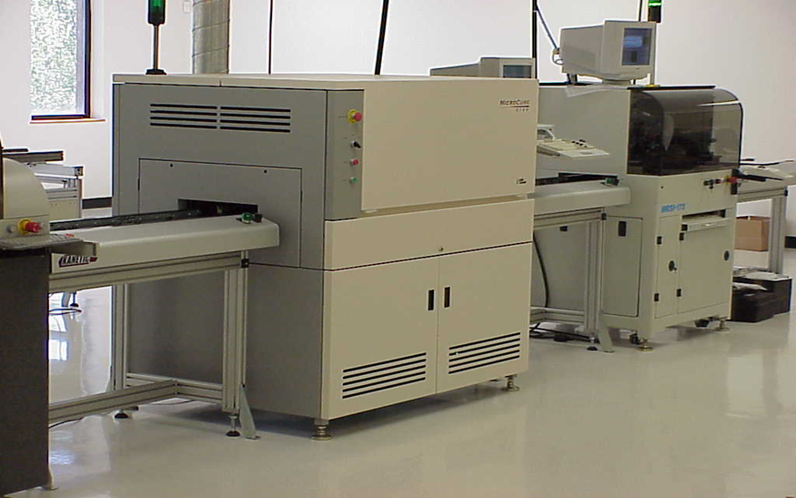
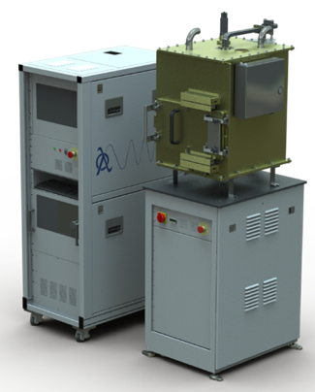
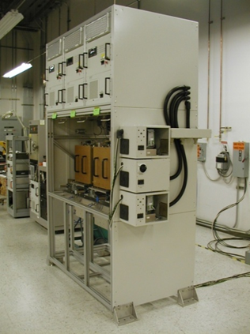
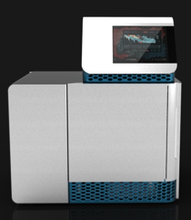
Lambda Technologies and VFM
Established in 1994, with >250 systems in production lines world-wide
Curing of thermoset and thermoplastic resins mostly
Electronics and industrial high volume applications primarily
  Microelectronics assembly for consumer devices
  Wafer dielectric layer coatings at semiconductor fabs
  Industrial applications in medical devices, aviation, energy, automotive
www.microcure.com

Slide 9
Lambda Technologies, Inc.
Exclusive license and patent position on VFM
Wide variety of applications but focus is on microelectronics
Currently over 100 production lines 24/7 world-wide
Lambda Technologies
Diamond Films
Microelectronics
Biological
Semiconductor
Dielectrics
Assembly, Encapsulation
Under-Fill, Die Attach
Batch Wafers
(Partnership)
Single Wafers

