Slide 1
Microwave Fundamentals

Slide 2
Why Microwaves?
Fast heating and curing
  This is the most commonly known use for heating with microwaves
The least known and most powerful is the ability to lower cure temperatures
  Polymer curing can be performed at much lower temperatures
    This reduces thermal stress for adhesion and molding
    Internal chemical stresses are reduced in the adhesives and composites
    Extent of cure reactions are fully complete at these lower temperatures
  Evaporation of moisture and solvents efficiently at low temperatures
    Removal of water/solvents from resins or slurries is volumetric
    Fast, uniform evaporation occurs from the whole bulk
Inherently selective heating allows uniquely focused processing
All of this is due to the molecular rotations created with microwaves

Slide 3
Microwaves are Rotational Energy
Electromagnetic Spectrum
  Gamma Rays Nuclei
  X-Ray Inner Electrons
  UV Covalent Bond Disruption
  Visible
  IR Molecular Vibration
  Microwaves Molecular Rotation
  RF Charge Flow
Note that no bonds are broken with microwave fields
Ionizing
Radiation
Non-Ionizing
Radiation

Slide 4
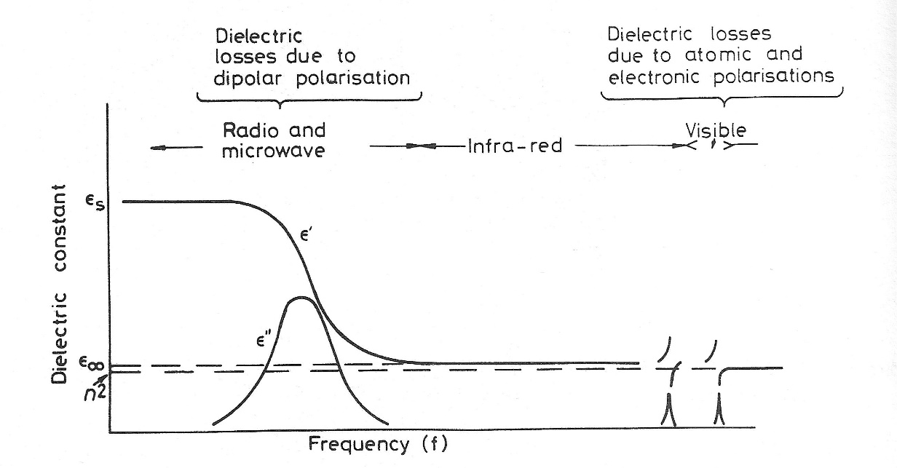
Dipole Rotation and Heat
Microwave fields excite electron distributions in molecules which cannot follow the rapid reverses in the e-field.
This causes a fall in the dielectric constant (ε’) and a rise in the dielectric loss factor (ε”) shown in the graph below.
Rapid dipole reorientation causes rotational motion and frictional heating between neighboring molecules.

Slide 5
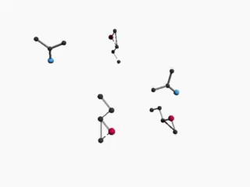
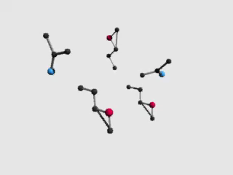
Inherently Different Heating Method
Heat enters from the outside-in or top-to-bottom of sample.
All the molecules are heated in the whole sample instantly.

Slide 6

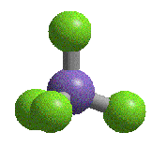
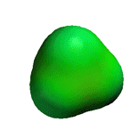
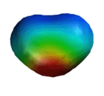
Microwaves Create Molecular Rotation
Water (H₂O)
Methane (CH₄)
Dipole Moment = 1.86 D
Dipole Moment = 0 D
Polarizability = 1.45 Å
Polarizability = 2.6 Å
Even molecular groups without dipoles will rotate!

Slide 7
Microwave Reaction Kinetics
The collision theory modified Arrhenius equation for reaction rate depends on both the collision frequency (Z) and the steric factor (ρ):
k = Z ρ e ^{(-Ea/RT)}
Increased molecular motion increases collision frequency (Z)
Rapid re-orientation at reactive sites increases productive collisions (ρ)
The increased reaction kinetics can be seen as either (or both) of:
  increased collision kinetics (Z and ρ)
  increased localized heating (energy of activation Ea)
The dipoles are rotated more actively at reaction sites than in the rest of the molecule, so
the bulk temperature is much lower

Slide 8
Selective Heating
  Glass &
  Ceramics
  Polymer
  resins
  Silicon
  (doped)
  Metals
transparent
absorptive
absorptive
reflective +
absorptive +
transparent

Slide 9
Metal Thickness Determines Effect
Metals only absorb at their skin depth
thicker - reflective
thinner - transparent

Slide 10
Practical Considerations
Power dissipation:
        P_{av} = ω ε₀ ε“_{eff} E²_{rms} V
    More power is required for larger sample volumes but;
Heating rate:
  (T – T₀)/t = ω ε₀ ε“_{eff} E²_{rms} V/MC_{p} °C
  (T – T₀)/t = ω ε₀ ε“_{eff} E²_{rms} V/ρ_{b}C_{p} °C
    Heating efficiency increases with larger sample volumes.
      P_{av} = average power dissipated
      Ω = angular frequency
      ε“_{eff} = dielectric loss factor
      E²_{rms} = electric field
      V = sample volume
      M = sample mass
      ρ_{b} = sample density
      C_{p} = heat capacity

Slide 11
Heating with Molecular Rotations
Molecular rotation is very efficient even in viscous materials
  Small water and solvent molecules evolve from resins and slurries all at once
  Reactions of monomers form polymers throughout the entire bulk
    Uniform heating is created rather than from the surface to the interior
    Glass formation (vitrification) does not occur even at low temperatures
    Highly stressed agglomerates with interfacial cracks do not form
    Low temperature decomposition does not occur
  Voids evolve quickly and uniformly without vacuum
Highly efficient chemical reactions proceed at low temperatures
Microwaves penetrate uniformly through large volumes (m³)
Microwaves do not heat glass, ceramics, or metals*
  Selective heating can be used for custom processing sequences
Variable Frequency Microwaves are uniform and do not cause metal arcing
* except at skin depth

